Slide 1



Student Depression Analysis
Using Combined machine learning Models Approach

Slide 2

Introduction
Student depression is a growing concern worldwide, with significant impacts on academic performance, personal growth, and overall well-being. Numerous factors, such as academic pressure, financial stress, and social challenges, contribute to this issue. Identifying these factors and predicting at-risk students can help institutions implement targeted interventions and support programs.

Slide 3
Goals
We aim to address the following questions:
What are the key factors contributing to student depression?
How can data modeling techniques help predict students at risk?
What insights can be derived to guide effective mental health support strategies?

Slide 4

Dataset
Student depression dataset
Why This Dataset is Suitable
Relevance: It covers key factors related to mental health, such as academic pressure, financial stress, and family history of mental illness. Includes variables directly related to depression and potential predictors.
Diversity of Variables:
Demographics: Gender, Age, City, Profession.
Academic factors: CGPA, Academic Pressure, Study Satisfaction.
Lifestyle habits: Sleep Duration, Dietary Habits, Work/Study Hours.
Mental health indicators: Suicidal thoughts, Family history of mental illness.
Data Size: 27,901 rows are sufficient for statistical analysis and modeling while being manageable for processing.

Slide 5
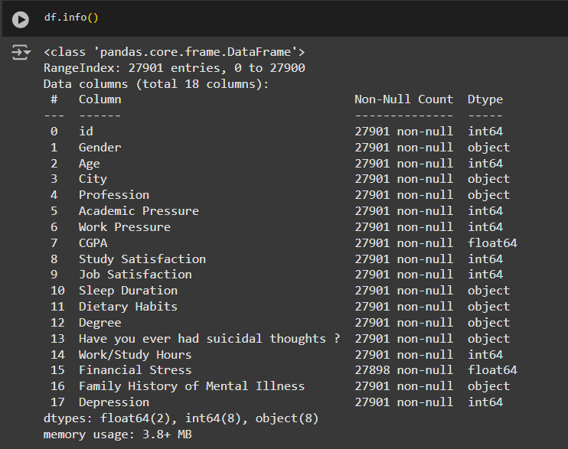
Our dataset prior analysis

Slide 6
Steps

Slide 7

Data Importing & loading
We start with importing the necessary libraries and tools for:
Data preprocessing
Data cleaning
Model building
Visualization
Evaluation
Saving final model
Setting Variables

Slide 8
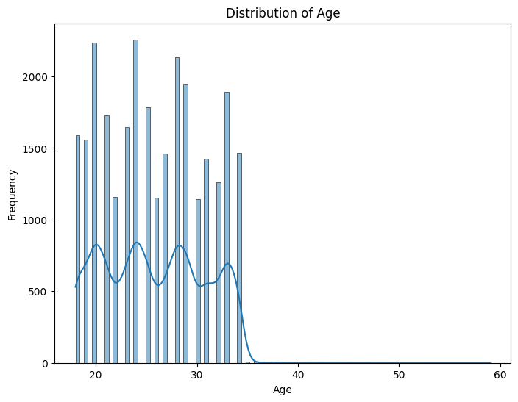
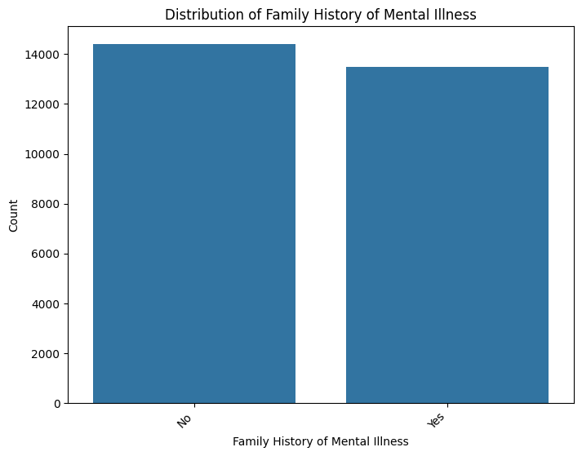
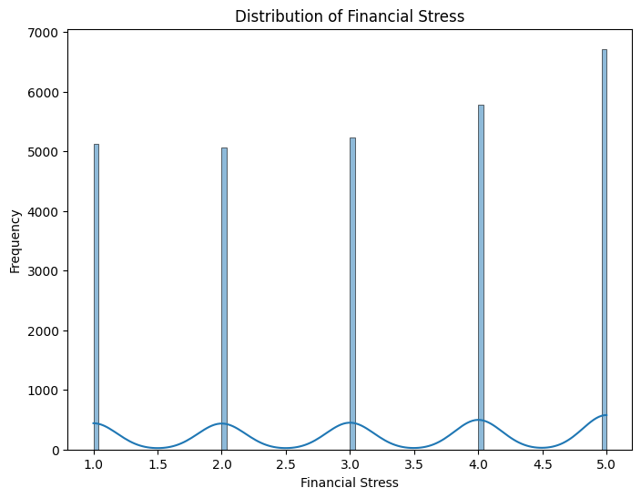
2- Explanatory Data Analysis (EDA)
Checking missing values
Explore Data Distributions

Slide 9
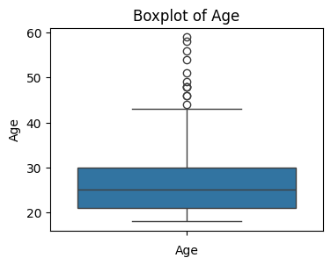
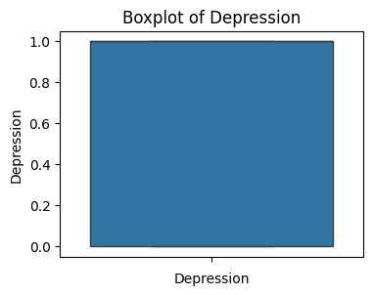
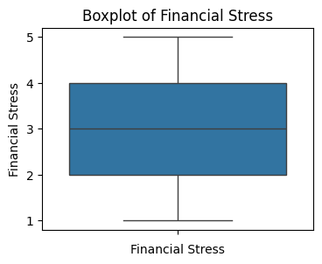
3- Check for outliers

Slide 10
4- Data cleaning & feature engineering
1- Handling missing values (There are 3 null values in Financial Stress column. Since 3 rows is only ~0.01% of the dataset, dropping them would not significantly affect the data size or quality.)
2- Remove unrelated rows (we need to remove rows where profession is not equal to student)
3- Remove unimportant features (ID, geographical location and degree type)
4- Grouping categorical data (Age and GPA)
5- Data encoding

Slide 11
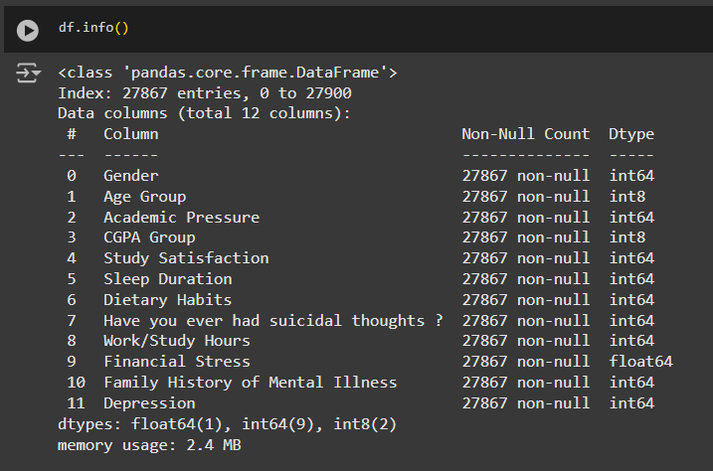
Our dataset after cleaning

Slide 12
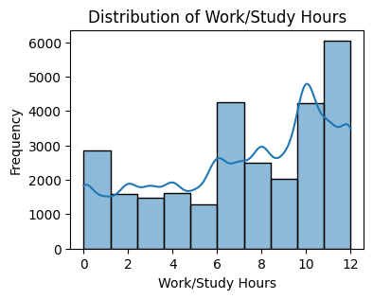
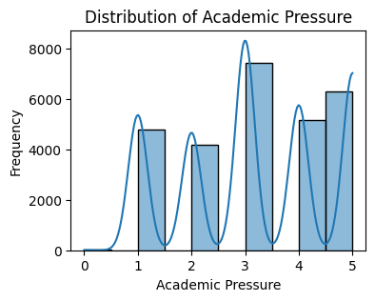
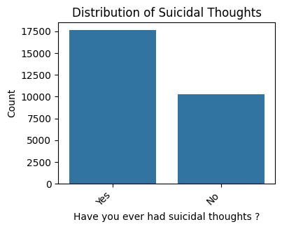
5- Post- Engineering Explanatory Data Analysis
Explore data distribution

Slide 13
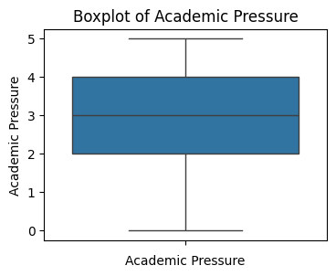
5- Post- Engineering Explanatory Data Analysis
Check for outliers

Slide 14
6- Data Modeling
Data Splitting
Crucial step in preparing data for a machine learning model. It involves splitting the dataset into two parts: one for training the model and the other for testing its performance.
Model Training
Creating and training individual machine learning models.
We use 4 models logistic regression, decision tree, random forests and support vector machine which are later combined to make a more robust prediction.

Slide 15

6- Data Modeling
Models evaluation
Each model was trained individually, used to predict data and got an evaluation based on the results.
Prediction results for each model

Slide 16

6- Data Modeling
We combine all the 4 models into a final Soft Voting Classifier
The final voting classifier is created and evaluated to predict student depression based on the features proposed.
We train the ensemble model, evaluates its performance using the F1 score, and saves the trained model for future use. This ensemble approach leads to more robust and accurate predictions compared to using each model individually.
Prediction results for the combined model​

Slide 17
Advantages
This approach provides a high level of flexibility and can result in improved model performance by leveraging the strengths of multiple ensemble strategies.
Diversity: The use of voting classifier with different base models adds diversity to the ensemble.
Final Ensemble: The final Voting Classifier combines all base models, offering a potentially higher-performing model.

Slide 18
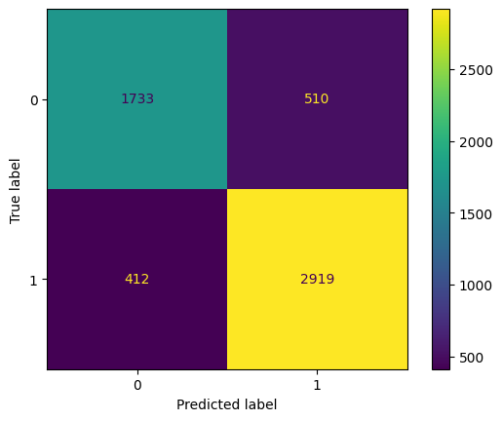
Data Visualization
The confusion matrix suggests that the model performs well in terms of correctly classifying both positive and negative classes.
However, some errors still occur, as indicated by the presence of false positives and false negatives.

Slide 19
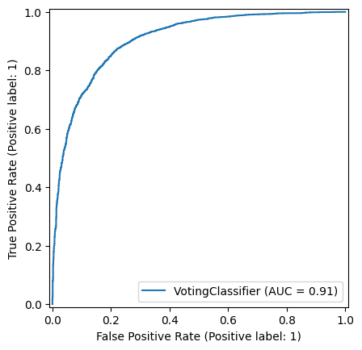
Data Visualization
ROC Curve and AUC
Purpose: Evaluate the trade-off between true positive rate (TPR) and false positive rate (FPR) for binary classification.
ROC Curve is generated using the model's predictions on test data to visually evaluate its ability to discriminate between the classes (in this case: presence or absence of depression)

Slide 20
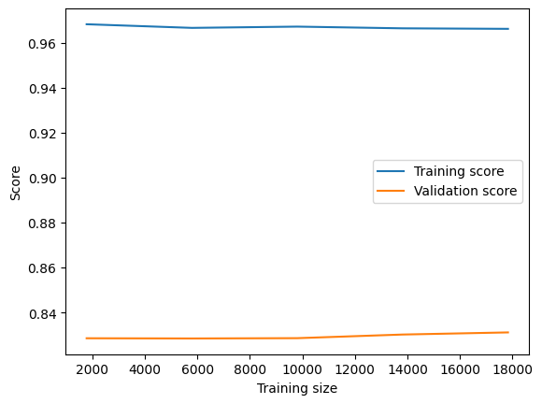
Data Visualization
Learning Curve: We observe that
The model performs almost perfectly on the training data, suggesting that it has a good capacity to learn patterns. However, if the training score were much higher than the validation score, it could indicate overfitting.
The validation score improves slightly with more training data, indicating that the model generalizes better as it sees more examples.
Both the training and validation scores appear to stabilize, meaning that increasing the training data further might have diminishing returns on performance.

Slide 21
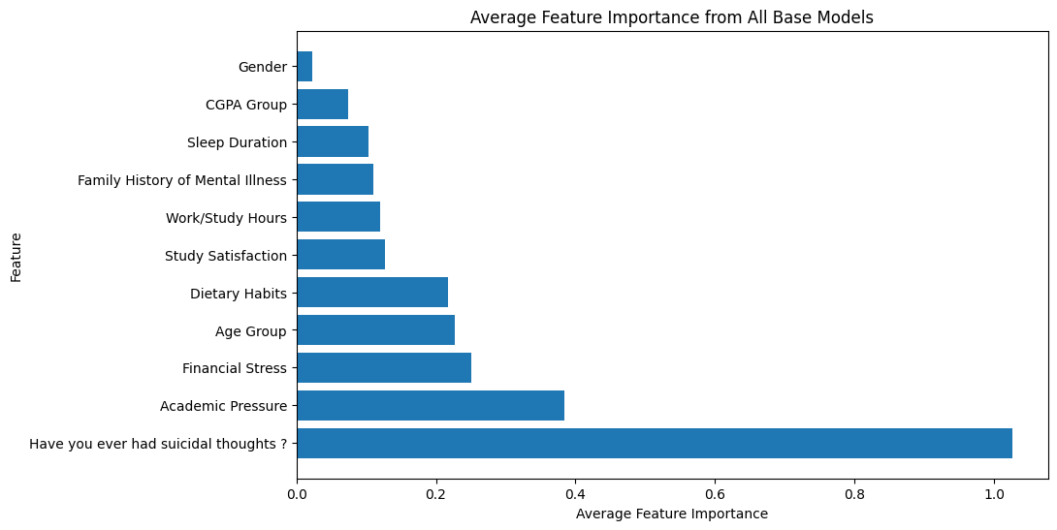
Data Visualization
The plot shows each feature and its impact on student depression

Slide 22
Interpreting the results
Key Factors Influencing Depression
"Have you ever had suicidal thoughts?" has the highest importance significantly more than any other feature, indicating that it is a strong predictor or influential variable.
Academic Pressure is the second most important factor, showing its strong relevance in the model.
Other factors like Financial Stress, Age Group, and Dietary Habits have moderate importance.
Factors such as Gender and CGPA Group have minimal importance, suggesting they contribute very little to the model's predictions.

Slide 23
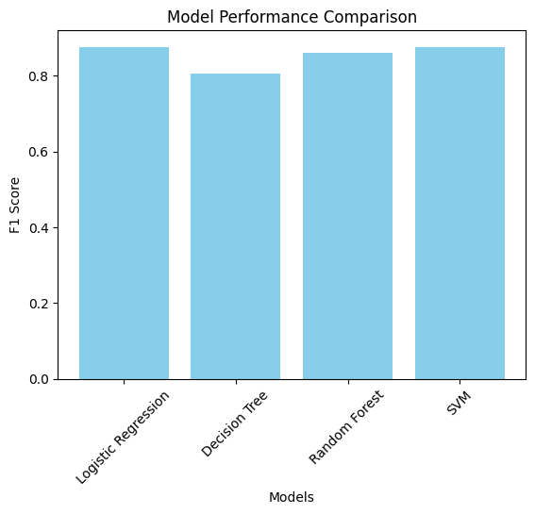
Data Visualization
The plot evaluates each model individually.

Slide 24
Interpreting the results
Interpreting the results using the 4 models used:
Logistic Regression: This model has a high F1 score, slightly below the highest performers, indicating strong overall performance in balancing precision and recall.
Decision Tree: This model has the lowest F1 score among the four, suggesting it may not handle the classification task as effectively as the other models.
Random Forest: This model achieves one of the highest F1 scores, demonstrating excellent performance and indicating its robustness in handling the classification task, possibly due to its ensemble nature.
Support Vector Machine (SVM): The SVM also performs very well, matching or slightly surpassing the performance of the Random Forest, which highlights its effectiveness in this task.

Slide 25

Recommended actions based on the analysis to overcome students' depression problem
According to the study it's crucial to take proactive and reactive actions to overcome student depression, so we may suggest:
Immediate Access to Counseling:
Provide confidential and immediate psychological support for students in distress.
Train counselors to handle crisis situations, including suicidal ideation.

Slide 26

Recommended actions based on the analysis to overcome students' depression problem
Crisis Helplines:
Promote 24/7 mental health hotlines for students to access help in emergencies.

Slide 27

Recommended actions based on the analysis to overcome students' depression problem
Promoting Healthy Lifestyles:
Organize wellness programs focusing on physical and mental health.

Slide 28

Recommended actions based on the analysis to overcome students' depression problem
Parental and Teacher Training:
Train parents and teachers to identify early warning signs of mental health issues.
Advocate for sufficient sleep, regular exercise, and balanced nutrition.

Slide 29

Recommended actions based on the analysis to overcome students' depression problem
Reduce Financial Stress:
Offer financial aid, scholarships, and workshops on managing personal finances.

Slide 30
Thank You!
Ahmed Hatem Fathy: Ahmed_201900022@fci.helwan.edu.eg
Haydi Mohamed Ahmed: Haydi_201900926@fci.helwan.edu.eg

